Slide 1
HACK $ DAY
HUMAN DISEASE PREDICTION USING ML

Slide 2
TEAM MEMBERS:
NAME | GMAIL ID
Y.VEERA VENKATA SATISH | 9921004787@klu.ac.in
V. Ajay | 99210042230@klu.ac.in
V. HARSHA | 99210041301@klu.ac.in
Y. SATYA VENKATA NAGA SHANKAR | 99210042243@klu.ac.in
K. SAI SRINIVAS | 9922004351@klu.ac.in

Slide 3
Contents
Abstract
Introduction
Objective
Existing system and Proposed System
Tools and Technology used
Algorithm
Architectural Design
Results
Conclusion
Future Enhancement
References

Slide 4
ABSTRACT
Most of the disease involves a consultation with doctors to get treated . With sufficient data detection of disease by an algorithm can be very easy and cheap. Detection of disease by looking at the symptoms is an integral part of treatment .
In our project we will try to accurately detect a disease by looking at the symptoms of the patient.
Medical facilities need to be advanced so that better decisions for patient diagnosis and treatment options can be made.
When Machine Learning is implemented in healthcare can lead to increase patient satisfaction.
“Disease Detection” system based on detective modelling detects the disease of the user on the basis of the symptoms that user provides as an input to the system. The system analyzes the symptoms provided by the user as input and gives the disease as an output.

Slide 5
OBJECTIVE
There is a need to study and make a system which will make it easy for an end users to detect the diseases without visiting physician or doctor for diagnosis.
The Accuracy will Increase using Machine Learning(Random Forest Algorithm).

Slide 6

INTRODUCTION
Human Disease Detection is a system which detects the disease based on the information provided by the user.
It also detects the disease of the patient or the user based on the information or the symptoms he/she enter into the system and provides the accurate results based on that information.
Human Disease Detection is completely done with the help of Machine Learning and Python Programming language with Tkinter Interface for it and also using the dataset that is available previously by the hospitals using that we will detect the disease.
People are looking online for health information regarding diseases. The main motive to develop this project is that a user can sit at their convenient place and have a check-up of their health.

Slide 7
Existing System And Proposed System
Existing system can detect the disease but not the sub type of disease. It fails to detect the condition of the patient. Existing model gives less accuracy.
Proposed system can detect the disease with more accuracy. With the use of machine learning algorithm the accuracy is increased. Random forest algorithm gives more accuracy than other algorithms.

Slide 8



TOOLS AND TECHNOLOGY USED
PYTHON
numpy
PYTHON
LIBRAR
-IES
pandas
MACHINE
LEARNING
sklearn

Slide 9
Random Forest Algorithm:
Random Forest is a popular machine learning algorithm that belongs to the supervised learning technique. It can be used for both Classification and Regression problems in ML. It is based on the concept of ensemble learning, which is a process of combining multiple classifiers to solve a complex problem and to improve the performance of the model.
Random Forest is a classifier that contains a number of decision trees on various subsets of the given dataset and takes the average to improve the predictive accuracy of that dataset.

Slide 10
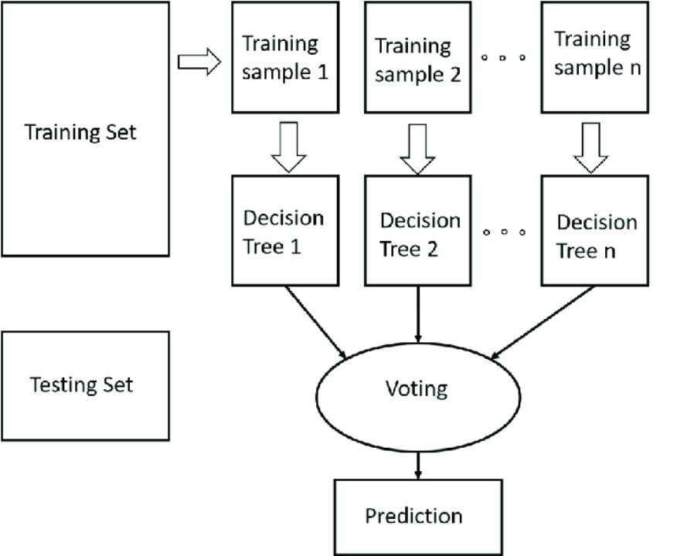
Random forest Classifier

Slide 11
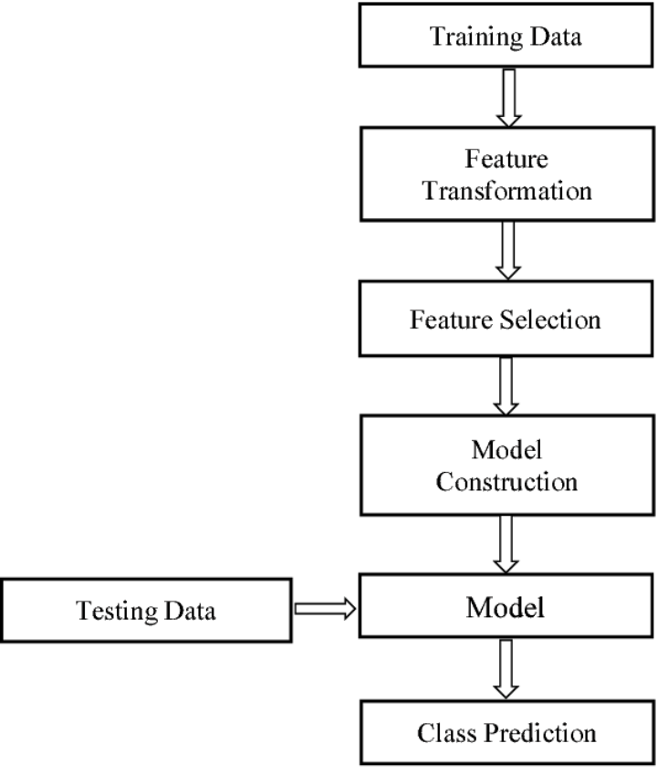
ARCHITECTURE DESIGN

Slide 12
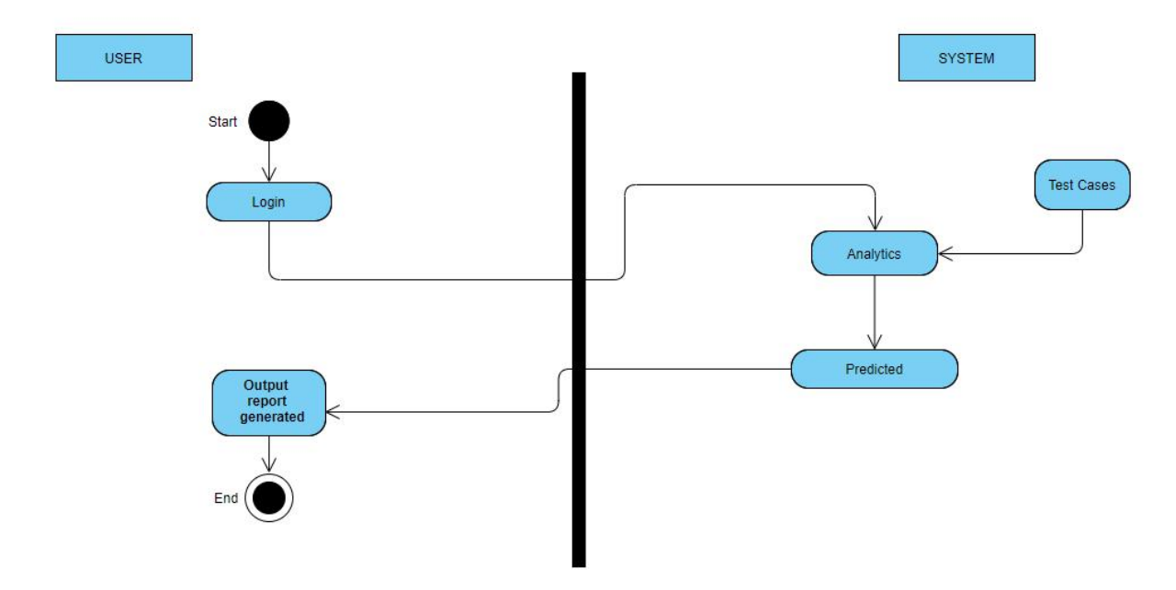
Activity Diagram

Slide 13
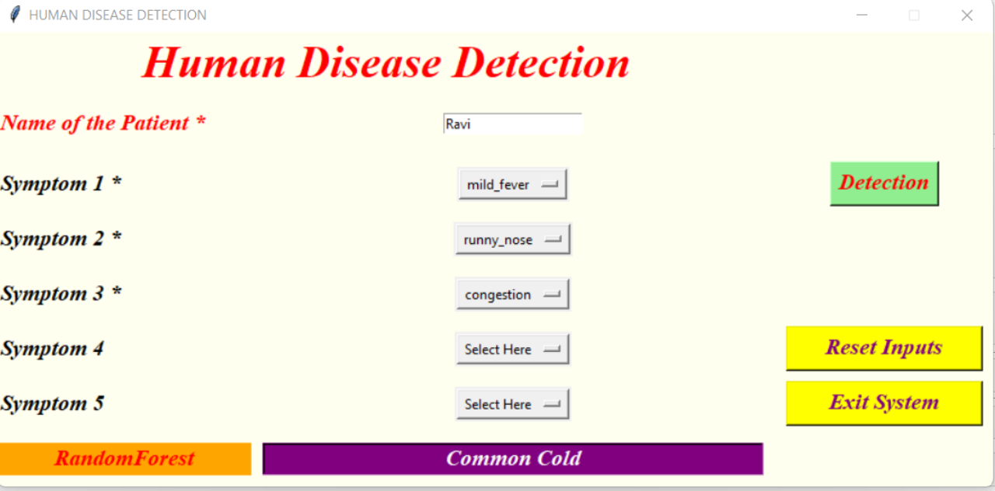
RESULTS

Slide 14
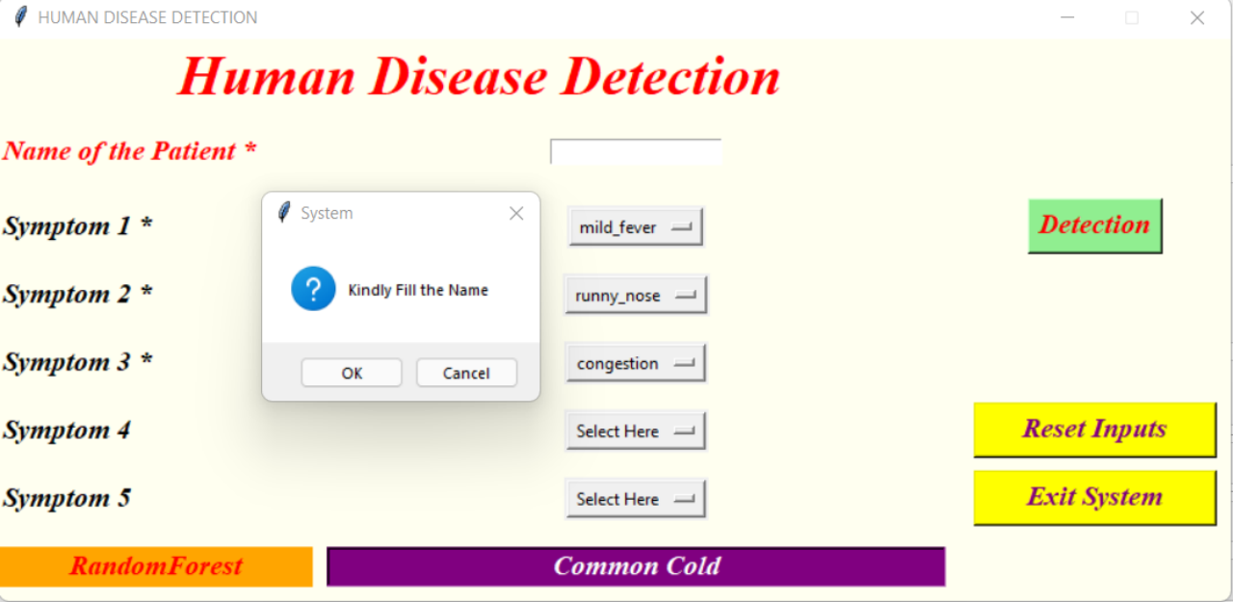

Slide 15
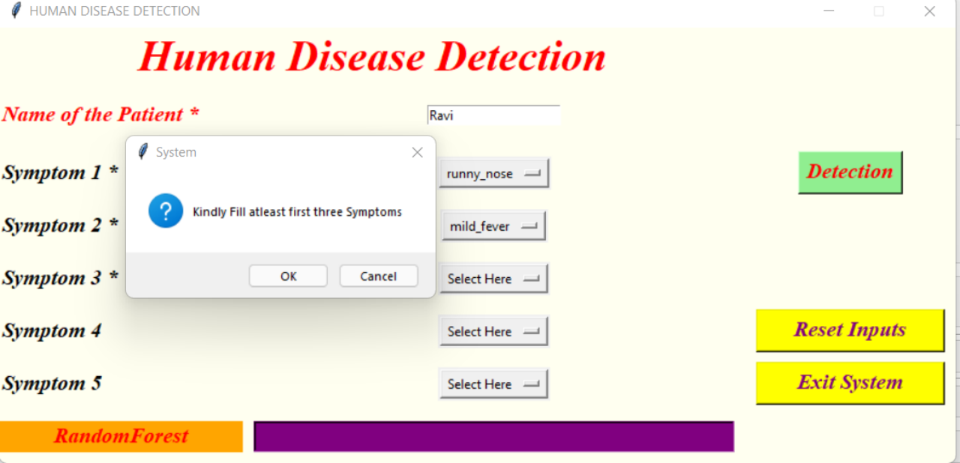

Slide 16
CONCLUSION
This project, Disease prediction using machine learning is very much useful in everyone ’s day to day life and it is mainly more important for the healthcare sector, because they are the one that daily uses these systems to predict the diseases of the patients based on their general information and there symptoms that they are been through.
Now a day’s health industry plays major role in curing the diseases of the patients so this is also some kind of help for the health industry to tell the user and also it is useful for the user in case he/she doesn’t want to go to the hospital or any other clinics, so just by entering the symptoms and all other useful information the user can get to know the disease he/she is suffering from
And the health industry can also get benefit from this system by just asking the symptoms from the user and entering in the system and in just few seconds they can tell the exact and up to some extent the accurate diseases.
If health industry adopts this project then the work of the doctors can be reduced and they can easily predict the disease of the patient.
The Disease prediction is to provide prediction for the various and generally occurring diseases that when unchecked and sometimes ignored can turns into fatal disease and cause lot of problem to the patient and as well as their family members.

Slide 17
FUTURE ENHANCEMENT
Facility for modifying user detail.
More interactive user interface.
Facilities for Backup creation.
Can be done as Web page.
Can be done as Mobile Application.
More Details and Latest Diseases.

Slide 18
REFERENCES
https://scholar.google.co.in/scholar?q=human+disease+prediction+system+using+data+mining+techniques&hl=en&as_sdt=0&as_vis=1&oi=scholart
https://www.irjet.net/archives/V5/i3/IRJET-V5I3930.pdf
https://www.irjet.net/archives/V6/i12/IRJET-V6I12122.pdf

Slide 19
THANK YOU

